Slide 1
Chapter :
Coding And Unit Testing
Notes:
Prepared By: Ashwin Raiyani

Slide 2
Topic Covered
Programming principles and guidelines
  Structured Programming
  Information Hiding
  Some Programming Practices
  Coding Standards
Incrementally Developing Code
  An Incremental Coding Process
  Test-Driven Development
  Pair Programming
Managing Evolving Code
  Source Code Control and Build
  Refactoring

Slide 3
Topic Covered
Unit Testing
  Testing procedural units
  Unit testing of classes
Code Inspection
  Planning
  Self-review
  Group review Meeting
Metrics
  Size Measures
  Complexity Metrics

Slide 4
Coding
Goal is to implement the design in best possible manner
Coding affects testing and maintenance
Aim of coding activity, to write code that reduces testing and maintenance costs
Hence, goal should not be to reduce coding cost, but testing and maintenance cost, i.e. make the job of tester and maintainer easier

Slide 5
Coding
Code is read a lot more
  Coders themselves read the code many times for debugging, extending etc
  Maintainers spend a lot of effort reading and understanding code
  Other developers read code when they add to existing code
Hence, code should be written so it is easy to understand and read, not easy to write!

Slide 6
Coding
Having clear objective for coding can help itself to achieve them
Weinberg experiment showed that coders achieve the goal they set
  In experiment, five diff. teams were given same problem.
  Each teams has different objectives.
  Objectives like, minimize effort to complete program, minimize the number of statement, minimize the memory required, maximize the program clarity, and maximize the output clarity.

Slide 7
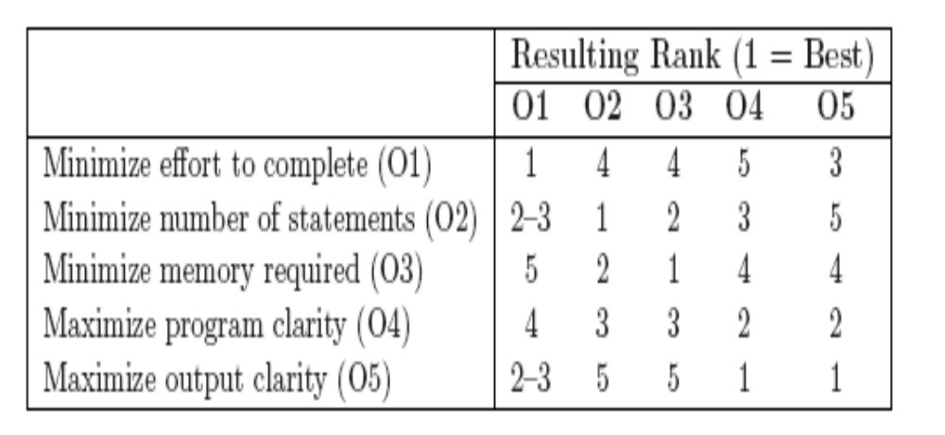
Coding
Weinberg Experiment

Slide 8
Coding
It was found that in most cases each team did the best for the objective that was specified to it.

Slide 9
Programming principles and guidelines
Main goal of programmer is write simple and easy to read programs with few bugs in it.
Additional goal is to write code quickly.
There are some general rules and guidelines, that will help to programmer write code that is easier to understand (and test)

Slide 10
Structured Programming
Structured programming started in the 70s, primarily against indiscriminate (i.e. random or not systematic) use of control constructs like gotos
Goal was to simplify program structure so it is easier to read and understand programs
Currently, structured programming is now well established and followed

Slide 11
Structured Programming
A program has a static structure as well as a dynamic structure
Static structure is the structure of the text of the program, which is linear organization of statements.
Dynamic structure of the program is the sequence of statements executed during the execution
In other words, both the static structure and the dynamic behavior are sequences of statements;
  In static, program is fixed.
  While in dynamic, it is change from execution to execution.

Slide 12
Structured Programming
The Goal of structured programming is to write programs whose dynamic structure is same as static
  I.e. statements are executed in the same order in which they are present in code.
Objective of structured programming becomes developing programs whose control flow during execution is linearized.
But, no meaningful program can be written as a sequence of simple statements without any branching or repetition

Slide 13
Structured Programming
To achieve linearizing control flow objective, use structured constructs(decision loop or iterative loops).
In structured programming, a statement is not a simple assignment statement, it is a structured statement.
Key property of a structured statement is that it has a single-entry and a single-exit.
With single-entry and single-exit statements, we can view a program as a sequence of (structured) statements.

Slide 14
Structured Programming
Using this, correspondence between the static and dynamic structures can be obtained
Most commonly used single-entry and single-exit statements are
  Selection: if B then S1 else S2
  if B then S1
  Iteration: While B do S
  repeat S until B
  Sequencing: S1; S2; S3;...

Slide 15
Structured Programming
Real motivation of structured programming is formal verification of programs.
To show that a program is correct, we need to show when program execute, output is as per expectation only.
For expected output, we need to specify output condition also.
These output condition work only for some set of input conditions (i.e. every input will not give expected output).

Slide 16
Structured Programming
Input conditions are known as pre-condition and output conditions are known as post-condition.
For verification, the basic theorem to be shown for a program S is of the form
P {S} Q
  P – pre-condition that holds before S executes
  Q – post-condition that holds after S has executed and terminated

Slide 17
Structured Programming
Overall, our basic objective is that the program be easy to understand and structured programming is a safe approach.
Without linear flow, composition is hard and verification difficult
But, SP also helps simplify the control flow of programs, making them easier to understand
SP is an accepted and standard practice today – modern languages support it well

Slide 18
Information Hiding
Software solutions always contain data structures that hold information
Programs work on these DS to perform the functions they want
In general only some operations are performed on the some of information
  I.e while issue a book, we just capturing enrollno, name, etc. rest of the information is hide from operation.

Slide 19
Information Hiding
Information hiding – the information should be hidden; only operations on it should be exposed
I.e. data structures are hidden behind the access functions, which can be used by programs
Information hiding reduces coupling
This practice is a key foundation of OO and components, and is also widely used today

Slide 20
Some Programming Practices
We have few rules that have been found to make code easier to read as well as avoid some of the errors.
Control Constructs: it is desirable that as much as possible single-entry, single-exit constructs be used.
But it is also desirable to use a few standard control constructs rather than using a wide variety of constructs,

Slide 21
Some Programming Practices
Gotos: Gotos should be used carefully and in a disciplined manner.
In gotos, forward transfers (or a jump to a later statement) is more acceptable than a backward jump.
Information Hiding: Use only when information hiding the data structure behind functions.

Slide 22
Some Programming Practices
User-Defined Types: use these to make the programs easier to read
  For example, when working with dates, a type can be defined for the day of the week.
Nesting: If nesting of if-then-else constructs becomes too deep, then the logic become harder to understand.
Avoid heavy nesting of if-then-else.

Slide 23
Some Programming Practices
Module Size: this issue related to system design. A programmer should carefully examine any function with too many statements.
Should not be too large because it is difficult to handle in precise manner.
Module Interface: As a rule of thumb, any module whose interface has more than five parameters should be carefully examined.
Broken into multiple modules with a simpler interface

Slide 24
Some Programming Practices
Side Effects: When a module is invoked, sometimes it has side effects of modifying the program.
For example, modifying global variables. Such side effects should be avoided where possible.
Robustness: program should have planned even for exceptional conditions.
For ex. exceptional conditions such as incorrect input, the incorrect value of some variable, and overflow.

Slide 25
Some Programming Practices
In that situation, instead of program crash or dump it should produce some meaningful message and exit gracefully.
Switch Case with Default: If there is no default case in a “switch” statement, the behavior can be unpredictable.
Good practice to always include a default case

Slide 26
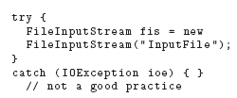
Some Programming Practices
Empty Catch Block: Whenever exceptions are caught, it is a good practice to take some default action, even if it is just printing an error message.

Slide 27

Some Programming Practices
Empty if, while Statement: This often occurs due to some mistake and should be caught.
Other similar errors include empty finally, try, synchronized, empty static method, etc. Such useless checks should be avoided.

Slide 28
Some Programming Practices
Return from Finally Block: One should not return from finally block, as it can create false viewpoint.
Correlated parameter: Should check for compatibility.
Trusted Data Sources: checks should be made before accessing the input data.
For example, while doing the string copy operation, we should check that the source string is null terminated

Slide 29
Some Programming Practices
Give Importance to Exceptions: To make a software system more reliable, a programmer should consider all possibilities and write suitable exception handlers to prevent failures or loss when such situations occur.

Slide 30
Coding Standards
Programmers spend more time reading code than writing code
They read their own code as well as other programmers code
Readability is enhanced if some coding conventions are followed by all
Coding standards provide rules and guidelines for programmers.
Every organization built there own coding standards.

Slide 31
Coding Standards
Generally are regarding naming, file organization, statements/declarations, and layout and comments
Some Java conventions discussed here.
Naming Conventions Some of the standard naming conventions that are followed often are:
  Package name should be in lower case (e.g. mypackage, edu.iitk.maths)

Slide 32
Coding Standards
Type names should be start with uppercase (e.g., Day, DateOfBirth, EventHandler)
Variable names should be starting with lowercase (e.g., name, amount).
Constant names should be all uppercase (e.g., PI, MAX ITERATIONS).
Method names should be starting with lowercase (e.g., getValue()).

Slide 33
Coding Standards
Private class variables should have the _ suffix and prefix _ also (e.g., “private int value_”).
Variables with a large scope should have long names;
  variables with a small scope can have short names;
  loop iterators should be named i, j, k, etc.
prefix is should be used for Boolean variables (e.g., isStatus should be used instead of status)

Slide 34
Coding Standards
Term compute can be used for methods where something is being computed; the term find can be used where something is being looked up (e.g., computeMean(), findMin()).
Exception classes should be suffixed with Exception (e.g., OutOfBoundException).

Slide 35
Coding Standards
Files: conventions on how files should be named, and what files should contain
  Java source files should have the extension .java
  Each file should contain one outer class and the class name should be the same as the file name.
  Line length should be less than 80; if longer continue on another line

Slide 36
Coding Standards
Statements : These guidelines are for the declaration and executable statements in the source code.
  Variables should be initialized where declared, and they should be declared in the smallest possible scope.
  Declare related variables together in a common statements. Unrelated variables should be declared separately
  Class variables should never be declared public.

Slide 37
Coding Standards
  Loop variables should be initialized immediately before the loop
  Avoid the use of break and continue in a loop
  Avoid the use of do ... while construct
  Avoid complex conditional expressions
Commenting and Layout:
  In general, comments should explain what the code is doing or why the code is there, so that the code can become almost standalone for understanding the system.

Slide 38
Coding Standards
Comments for a module are often called prologue (i.e. introduction or preface) for the module.
  which describes the functionality
  its public interface and how the module is to be used,
  parameters of the interface,
  Assumptions and any side effects it has

Slide 39
Coding Standards
Comments guidelines are:
  Single line comments for a block of code should be aligned with the code they are meant for.
  There should be comments for all major variables explaining what they represent.
  A block of comments should be preceded by a blank comment line with just “/*” and ended with a line containing just “*/”.
  Trailing comments after statements should be short, on the same line.

Slide 40
Coding Standards
Layout guidelines focus on how a program should be indented, how it should use blank lines, white spaces, etc., to make it more easily readable.
Most programmers learn these by seeing the code of others and the code fragments in books and documents.

Slide 41
Incrementally Developing Code
Coding starts when some form of design and specification for modules are available.
Usually modules are assigned to programmers for coding.
For coding, developers use different processes such as
  Incremental Coding Process
  Test Driven Development
  Pair Programming

Slide 42
An Incremental Coding process
Usual process, programmer developed code for assign module and perform unit testing on it, fix the bugs found.
A better process is to do incrementally.
In this, write code for implementing only part of the functionality of module.
This code is complied and tested

Slide 43
An Incremental Coding process
If Code passes the tests, developer proceeds to add further functionality and test again.
Simple mean, code is developed incrementally and perform testing as it is built.

Slide 44
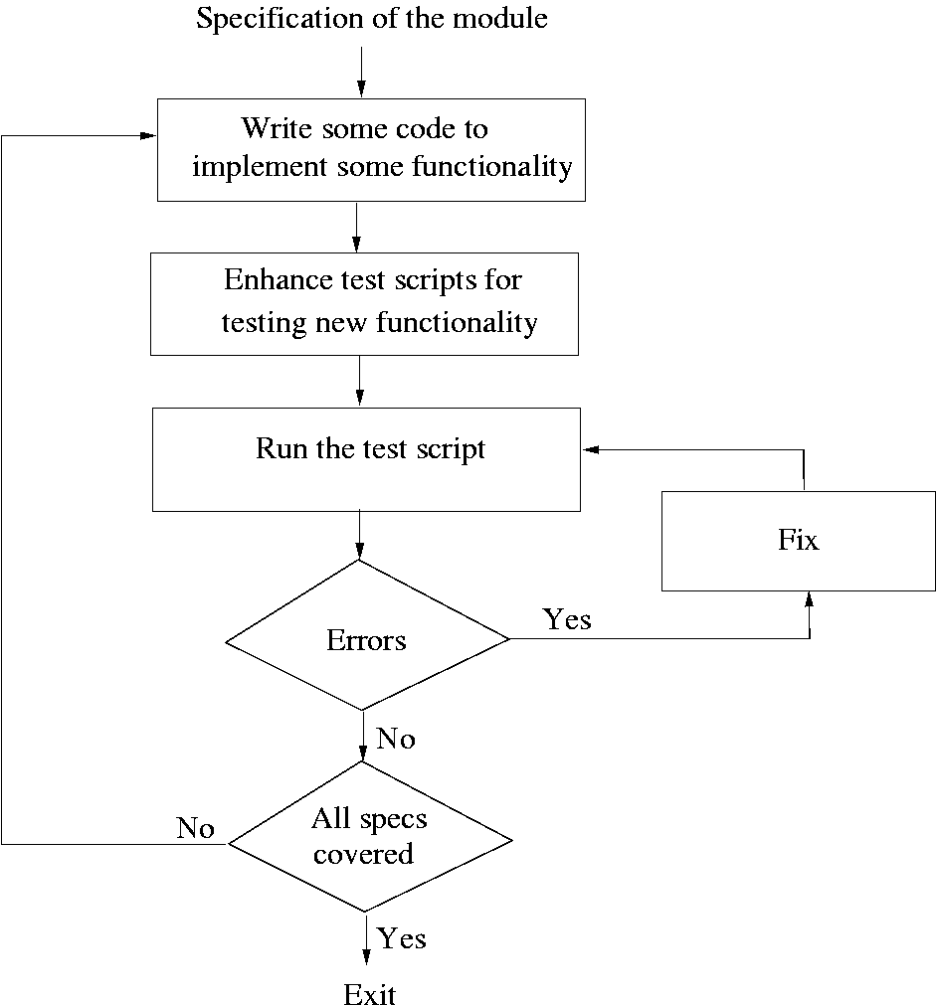
An Incremental Coding process

Slide 45
An Incremental Coding process
Basic advantage is testing being done after every round of coding.
It is essential that testing be should run through test scripts (i.e. test cases).
With this test scripts, testing can done frequently also.
Again this test scripts will help when future enhancement is there.

Slide 46
Test Driven Development
Test-Driven Development (TDD) is a coding process, in which, changes the order of activities in coding.
In TDD, programmer first writes the test scripts and then writes the code to pass the test cases in the script.
Again this is done incrementally.
This is a relatively new approach, and is a part of the extreme programming (XP) (used for improve software quality and responsiveness to changing customer requirements

Slide 47
Test Driven Development
Few notes about TDD:
In TDD, you write just enough code to pass the test
I.e. Code is always in sync with the tests and gets tested by the test cases
In this approach, write few tests which covers only some parts of the code.
So responsibility to ensure that all functionality is there is on test case design, not coding.

Slide 48
Test Driven Development
Task of test cases to check that the code will cover all functionality.
In TDD, focus shifts to how code will be used as test cases are written first
  Helps validate user interfaces specified in the design
  Focuses on usage of code
Functionality prioritization happens naturally (i.e. higher priority and lower priority)

Slide 49
Test Driven Development
But drawback is there are possibility that special cases for which test cases are not possible get left out (i.e. lower priority).
As the code is written to satisfy the test cases, the completeness of the code depends on the thoroughness of the test cases.
Again, hard and tedious to write test cases for all the scenarios or special conditions.
In this case, the code should be improved before new functionality is added

Slide 50
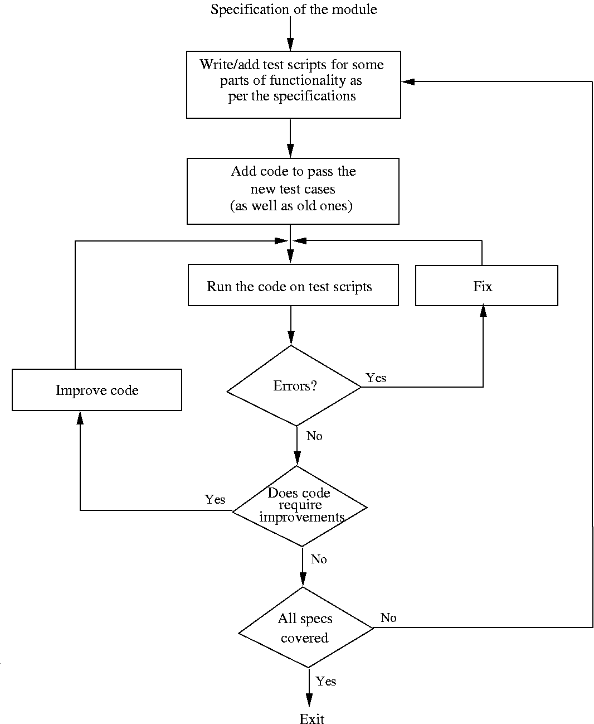

Slide 51
Pair Programming
Also a coding process that has been proposed as key practice in XP
In pair programming, Code is written by pair of programmers rather than individuals
In this process,
  One person types the code, the other actively reviews what is being typed.
  Errors are pointed out and together solutions are formulated.

Slide 52
Pair Programming
  The pair together design algorithms, data structures, strategies, etc.
  Roles are rotate periodically
Motivation of this technique is code reading and code reviews found to be very effective in detecting defects.
Besides ongoing code review, having two programmers, result in better decisions about the data structures, algorithms, interfaces, logic, etc.

Slide 53
Pair Programming
Potential drawback, pair programming, may result in loss of productivity by assigning two people for a programming task.
Again, there are also issues of accountability and code ownership (particularly when the pairs are not fixed and rotate)
In this technique, Effectiveness is not yet fully known

Slide 54
Managing Evolving Code
During coding process, code written by a programmer evolve (i.e. change).
Code changes due to change in module specification, which may due to requirement changes.
In such dynamic scenario, it is difficult handle and manage evolving code.
So here we have two aspect -
  How to manage different version
  How to maintain code quality under changes.

Slide 55
Source Code Control and Build
Each programmer creates different source files, which are eventually combined together to create executables.
In order to keep control over the sources and their evolution, we can use tools like
  CVS(Concurrent Version System) on UNIX (www.cvshome.org) or
  Visual source safe (VSS) on Windows.

Slide 56
Source Code Control and Build
A tool consists of repository, which is a controlled directory structure
The repository is the official source for all the code files
This allows any older version of the file to be re-created.
Project Manager assign necessary permission to programmer on this repository for making changes in source file.

Slide 57
Source Code Control and Build
Tool typically provides many commands to programmers
Get a local copy(Check Out) : programmer works on a local copy of the file.
  Command is cvs checkout <module>, which copies set of file that belongs to module on the local machine.
  Many users can check out a file.
Make changes to file(s) (Check in): changed files are uploaded in the repository and change is then available to all.

Slide 58
Source Code Control and Build
  Command is cvs commit <file>, after committing only changes are reflected to all.
Update a local copy : Changes committed by project members to the repository are not reflected in the local copies.
  For getting the changes, the local copies of the files have to be updated (e.g., by cvs update command).

Slide 59
Source Code Control and Build
Get reports: include reports like the difference between the local file and the latest version of the file
  All changes made to a file along with the dates and reasons for change (provided committing changes)
Normal behavior of a project member will be as follows:

Slide 60
Source Code Control and Build
  Check out the latest version of the files to be changed;
  Make the planned changes to them;
  Validate that the changes have the desired effect
  Commit the changes back to the repository
All tools will detect conflict when there is second person is committing on depository.
Conflicts are usually rare as they occur only if different changes are made to the same lines in a file.

Slide 61
Source Code Control and Build
With help of source code control system, does not need to maintain all the versions.
Besides this, it is also used for constructing the software system from the sources—an activity called build.
Build gets latest version and create executable from the sources.
Hence , we can say that Source code control is an essential tool for developing large projects and for coordination

Slide 62
Refactoring
As code evolves, the design becomes more complex to handle.
In other words, code evolves, productivity and quality start decreasing.
Refactoring is a technique to improve existing code by improving its design
Refactoring is not about improving a design during the design stages. But, about improving design of code.

Slide 63
Refactoring
In other words, refactoring, though done on source code, has the objective of improving the design that the code implements
Again, Refactoring will important role in TDD. (i.e. in code improvement step).
Refactoring is defined as a change made to the internal structure of software to make it easier.
  To understand and cheaper to modify without changing its behavior.

Slide 64
Refactoring
By applying refactoring, we have following results:
  Reducing coupling
  Increased Cohesion
Sometimes, by applying refactoring, we may need to change external behavior of software.
Main risks of refactoring is existing working code may “Break” (i.e fail) due to change.

Slide 65
Refactoring
To mitigate this risk, we have two golden rules are:
  Refactor in small steps.
  Have test scripts (i.e. test cases) available to test existing functionality.
For refactoring, extra cost is applied.
  Which ultimately reducing testing and debugging cost,
  Increasing quality
  Reducing effort.

Slide 66
Refactoring
When refactoring is needed?
There are some spot in code which indicate there is potential of improving the design.
Some spot like:
  Duplicate Code (i.e. small functionality executed at multiple places)
  Long Methods (i.e. do too many things and there is not cohesive)
  Long Class (i.e. implementing multiple concepts)
  Long Parameter List (i.e specifically in design interface)

Slide 67
Refactoring
  Switch Statements (i.e. implement polymorphism concepts instead of putting switch statement because it is harder to extend code).
  Too much communication between objects( such as like method of one class making many calls to methods of another objects)
  Message changing ( like one method is calling another method which increase coupling )

Slide 68
Unit Testing
Unit Testing perform at the programmer level.
Focus is on testing smaller programs or modules which are typically assigned to programmers.
A unit may be function or collection of function or class or collection of classes for program only.
A programmer will execute the unit with a variety of test cases.

Slide 69
Unit Testing
If program fails, programmers will find defect in the program (activity called debugging) and fix it.
Issue with Unit testing is that it is not complete system testing but it is just part.
Again there are some issues relevant to dependencies also.
  i.e. execution may depend on other unit which is yet not developed.
Due to this, unit testing often requires drivers or stubs to be written.

Slide 70
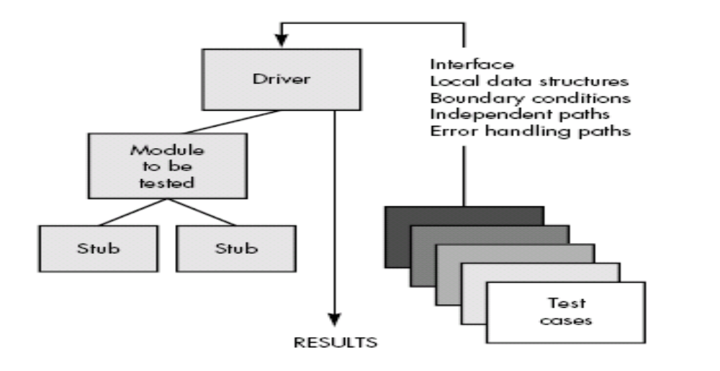
Unit Testing

Slide 71
Unit Testing
Drivers responsible for getting the test data and then reporting the result.
Stubs are essentially “dummy” modules to facilitate unit testing.
  for exa. Module M uses data from another module N that has not yet been developed
  Then for unit testing M, some stub for N will have to be written so M can invoke the data so unit testing can proceed.
Need for stubs can be avoided, if testing proceed with bottom-up manner.
  Module at lower levels are coded and tested first.

Slide 72
Unit Testing
Here we some approached for unit testing using testing frameworks
  Testing Procedural Units
  Unit testing of classes
In unit testing, behavior of a module depends on
  Value of its parameters
  Overall state of the system of which it is a part (e.g., states of global variables)
The actual values and the state of the system for a test case depend on test case.

Slide 73
Unit Testing – Testing Procedural Units
In addition, if a module f() has other modules below it in the structure chart, that is, g() and h(), then for executing f() we must have code for g() and h() also available.
It can be handle with two ways
  First approach is to test in a bottom-up manner. i.e. test the modules at the bottom of the structure chart first, and then move up.
  Ex. when testing f(), the tested code for g() and h() will be available

Slide 74
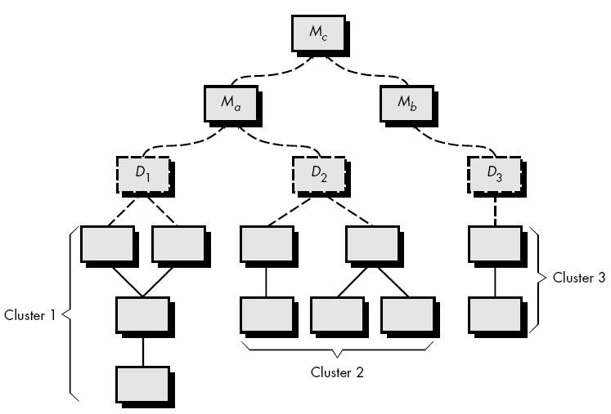
Unit Testing – Testing Procedural Units

Slide 75
Unit Testing – Testing Procedural Units
Second approach is write stubs for g() and h().
Stubs are throwaway code written for the called functions only to facilitate testing.
Often the stub for a function will just print some statement,
  If some value is to be returned for the caller to proceed, then few values will be hard coded in the stub.
So will assume that bottom up approach is followed.

Slide 76
Unit Testing – Testing Procedural Units
So, Testing of a module f() by a test case will then involve the following steps:
  Set the system state as needed by this test case.
  Set value of parameters suitably.
  Call the procedure f() with the parameters.
  Compare result of f() with expected results.
  Declare whether the test case has succeeded or failed.

Slide 77
Unit Testing – Testing Procedural Units
Common approach is to write a main_program() which executes first 3 steps.
  Can through input by tester
  Read from file
  Hard coded in the program.
  Print out the important values.
Last two statements, comparing results with expected results and decide whether test has succeeded or failed

Slide 78
Unit Testing – Testing Procedural Units
In a testing framework,
  Often a test case will be declared as a function which includes the checking outcome and declaring the result.
A test suite is then a collection of these functions, and execution of a test suite means each of the functions is executed.
If a test case fails, then the test framework will decide whether to continue executing or stop.
There is one driver function to which these suites are passed and which then executes all the test cases.

Slide 79
Unit Testing- Testing of Classes
To test a class, programmer need to create object of that class.
  Take the object to a particular state, invoke a method on it, and then check whether the state of the object is as expected.
There are Many frameworks exist for OO – Junit is the most popular;

Slide 80
Unit Testing- Testing of Classes
Each test case is a method, in which the desired sequence of methods is executed; assertions used to check the outcome
If all the declaration in all the methods succeed, then Junit declares that the test has passed.
If any declare statements fail, Junit declares that testing has failed and specifies the statements that has failed.

Slide 81
Unit Testing- Testing of Classes
Example how Junit can be used to testing a class
For testing of a class CUT (class under test) with Junit, the tester has to create another class which inherits from Junit.
  (e.g., class CUTtest extends Junit)
This class is the driver for testing CUT.
It must have constructor for which test cases are created.

Slide 82
Unit Testing- Testing of Classes
Create setUp() method for setting values before executing test case.
suite(): This method is used to create a test suite,
Most of methods are often named testxxxx() (i.e. typically focuses on testing a method under some state)
To check the results, Junit provides two special methods Assert- True(boolean expression) and AssertFalse(boolean expression).

Slide 83
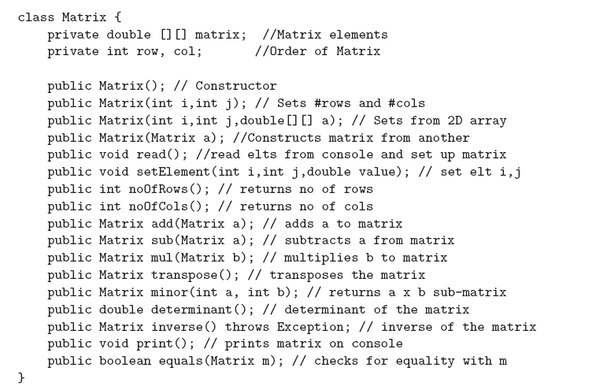


Slide 84
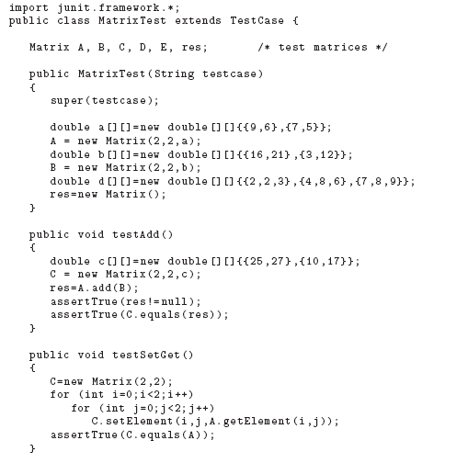

Slide 85
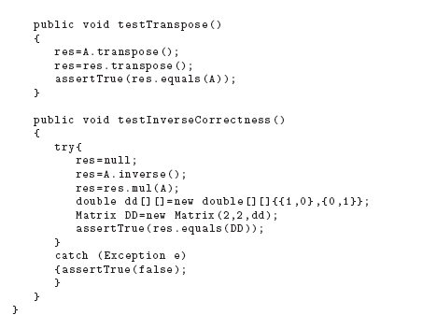

Slide 86
Code Inspection
Code inspection is a review of code by a group of peers.
Basic goal of inspections is to improve the quality of code by finding defects.
It can be viewed as “static testing” in which defects are detected in the code not by executing the code but through a manual process.
key characteristics of inspections are:
  Code inspection is conducted by programmers and for programmers.

Slide 87
Code Inspection
  It is a structured process with defined roles for the participants.
  The focus is on identifying defects, not fixing them.
  Inspection data is recorded and used for monitoring the effectiveness of the inspection process.
Inspections are performed by a team of reviewers including author with moderator.

Slide 88
Code Inspection
Moderator has the overall responsibility to ensure that the review process is done completely.
There are different stages in this process are:
  Planning,
  Self-review,
  Group review meeting, and
  Rework and follow-up.
These stages are generally executed in a linear order.

Slide 89
Code Inspection - Planning
Objective of the planning phase is to prepare for inspection.
An inspection team is formed. A team consists of at least three people. ( which includes programmer and moderator).
Author of the code ensures that the code is ready for inspection and entry criteria are satisfied.
Entry criteria are
  Code compiles correctly
  Static analysis tools have been applied
Moderator checks that the entry criteria

Slide 90
Code Inspection - Planning
A package is prepared that is to be distributed to the inspection team.
Package consists of
  Code to be inspected,
  The specifications for which the code was developed, and
  The checklist that should be used for inspection.
Moderator may arrange a meeting and author will give brief overview about product.

Slide 91
Code Inspection – Self-review
In this phase, each reviewer does a self-review of the code
Reviewer goes through the entire code and logs all the potential defects in the self-preparation log.
Reviewers also record the time they spent in the self-review.
A standard form may be used for the self-preparation log

Slide 92
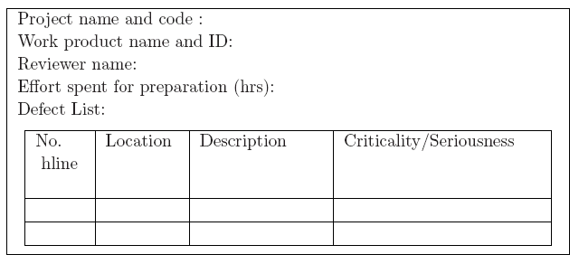
Code Inspection – Self-review

Slide 93
Code Inspection – Group review Meeting
Basic purpose of this is to prepared final defect list, based on defects reported by the reviewers and the new ones found during meeting.
Main outputs of this phase are the defect log and the defect summary report.
Moderator first checks if all reviewers preparation are adequate or not, if not then group review is postponed until all are fully prepared.

Slide 94
Code Inspection – Group review Meeting
Meeting is conducted as follows:
  A team member (called the reader) goes over the code line by line
  At any line, if any reviewer has any issue or finds any new issue in the meeting, reviewer can raises the issue.
  The author accepts the issue as a defect or clarifies why it is not a defect.
  After discussion an agreement is reached and one member of the review team (called the scribe) records the identified defects in the defect log.

Slide 95
Code Inspection – Group review Meeting
At the end of the meeting,
  Scribe reads out the defects recorded in the defect log for a final review by the team members.
  Note that during the entire process of review, defects are only identified.
  It is not the purpose of the group to identify solutions—that is done later by the author.
The final defect log is going to prepared as summary report of an inspection.

Slide 96
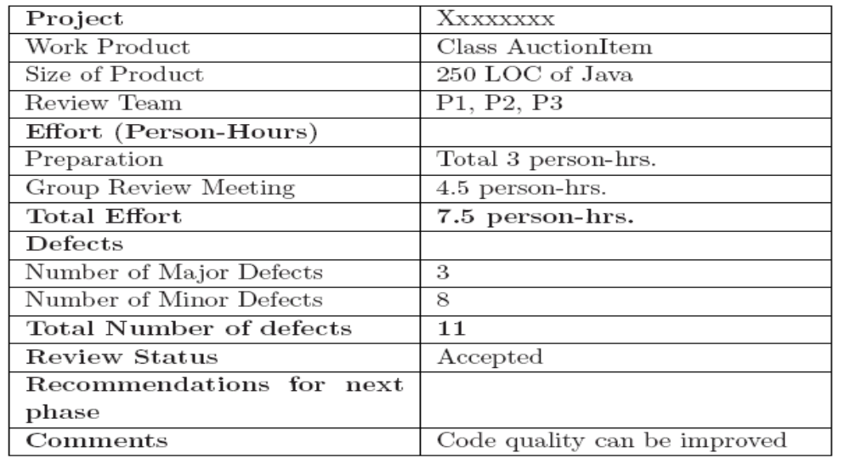
Code Inspection – Group review Meeting

Slide 97
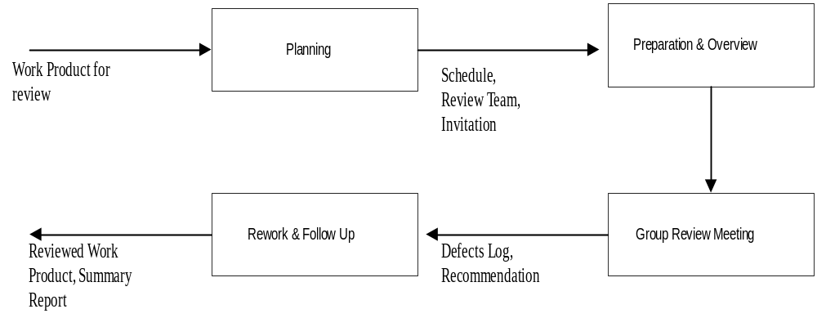
Code Inspection – Summary

Slide 98
Metrics
Work on metrics has focused on the final product i.e. code.
For the code, the most commonly used metrics are size and complexity.
  Size measure
  Complexity Measure

Slide 99
Size Measures
Main reason for size measures is , size is the major factor that affects the cost of a project
Relationship of size with the cost and quality that makes size an important metric.
Also used to measure productivity during the project (e.g., KLOC per person-month).
Final quality delivered by a process is also frequently normalized with respect to size (number of defects per KLOC).

Slide 100
Size Measures
LOC is heavily depend on programming language.
Most common measure of size is delivered lines of source code, or the number of lines of code (LOC) finally delivered.
While counting the LOC the simplest standard is
  Don’t count blank and commented lines
  Count everything else.

Slide 101
Size Measures
Here, Halstead has proposed metrics for length and volume of a program based on the number of operators and operands.
This measures are based on four scalar numbers derived directly from a program’s source code:
  n1 is number of distinct operators
  n2 is number of distinct operands
  N1 is total number of operators
  N2 is total number of operands
From these numbers, some measures are derived:

Slide 102
Size Measures
Program length:
  Length of program is total usage of operator and operands in the program.
  Length N = N1 + N2
Program Vocabulary
  Program vocabulary is the number of unique operators and operands used in the program
  Vocabulary n = n1 + n2
Program Volume
  Program volume can be defined as minimum number of bits needed to encode the program
  Volume V = N * Log₂(n)

Slide 103
Size Measures
Guidelines for calculating operands and operators
Operands:
  All variable and constants are considered as operands
  Array, array name and index are operands
  In goto statement, label is operand
  All hash directives are ignore
  Comments are not considered

Slide 104
Size Measures
Operators
  Functions calls are considered as operators
  Reserved words, return, break, default, continue are all operators
  Brackets, commas, semicolons are operators.
  In goto statement, goto is operators
  Looping statements are operators

Slide 105
Size Measures - Halstead
Example:
Void Swap( int a [], int i)
{
int temp;
temp = a[i];
a[i] = a[i+1];
a[i+1] = temp;
}

Slide 106
Size Measures - Halstead
Operands | Occurrences | Operator | Occurrences
swap | 1 | () | 1
a | 5 | {} | 1
i | 5 | void | 1
temp | 3 | int | 3
1 | 2 | [] | 5
 |  | , | 1
 |  | ; | 4
 |  | = | 3
 |  | + | 2
5 | 16 | 9 | 21

Slide 107
Complexity Metrics
If complexity is measured in terms of lines of code then it may vary from system to system.
Similarly, complexity has great impact on the cost of maintaining a program
We have some complexity measures that have been proposed.
  Cyclomatic complexity
  Halstead’ measure
  Know count

Slide 108
Cyclomatic Complexity Metrics
Basically in program, conditions and control statements add complexity to a program
Given two programs with the same size, the program with the larger number of decision statements is more complex.
In other word, no. of constructs that represent branches in program such as if then else, do while, repeat until and goto

Slide 109
Cyclomatic Complexity Metrics
Cyclomatic complexity measure proposed by McCabe, which is a graph-theoretic–based concept.
To do cyclomatic complexity, we need to first draw Control Flow Graph(CFG)
CFG describe code segments and their sequencing in a program.
It is directed graph in which
  Nodes represent a code segment; nodes are labeled using letters or numbers

Slide 110
Cyclomatic Complexity Metrics
  Edge represent conditional transfer of control between code segments; edges represent by arrow.
In CFG,
  Entry node, which is a node with no inbound edges.
  Exit node, which is a node with no outbound edges
When we translating code segment into flow graph, separate node is created for each condition.

Slide 111
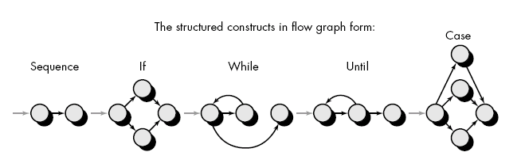
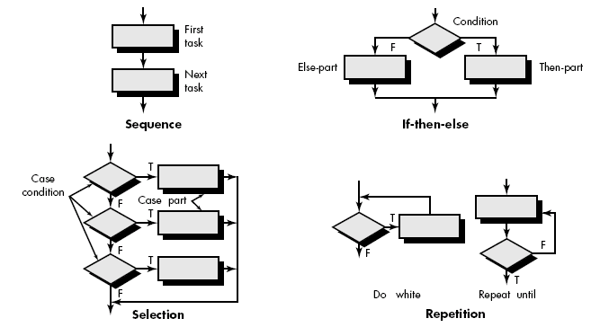

Slide 112
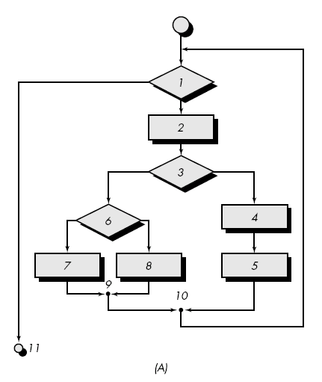
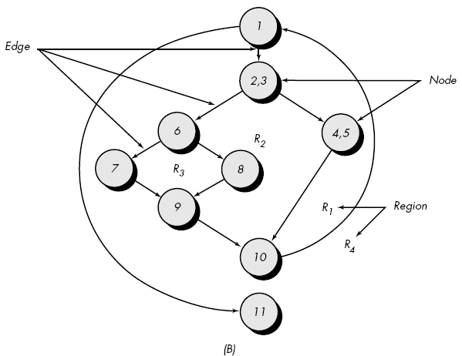
Fig. A represent program control structure and fig. B maps the flowchart into a corresponding flow graph.

Slide 113
Cyclomatic Complexity Metrics
There are 3 different methods through which we can find cyclomatic complexity:
For graph G with n nodes, e edges
V(G) = E – N + 2
Where E is no. of edges in CFG, N is no. of nodes in CFG.
Count total no. of regions presence in CFG cyclomatic complexity.
Cyclomatic complexity, V(G), for a flow graph, G, is also defined as
V(G) = P + 1
where P is the number of predicate nodes edges

Slide 114
Cyclomatic Complexity Metrics
Regions : Areas bounded by edges and nodes.
  When counting regions, we include the are outside the graph as a region.
predicate node: Each node that contains a condition.
  It is characterized by two or more edges comes from it
A sequence of process boxes and decision diamond can map into a single node.
One suggestion is that cyclomatic complexity should be less than 10

Slide 115
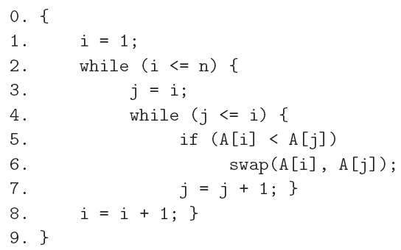
Cyclomatic Complexity Metrics - Problem

Slide 116
Cyclomatic Complexity Metrics - Solution
A
0,1,2
B
3,4
G
9
C
5
F
8
E
7
D
6

Slide 117
Cyclomatic Complexity Metrics
Once we have cyclomatic complexity value with us, we need to determine independent path in program.
An independent path is any path through the program that introduces at least one new set of processing statement or new condition.
Consider below given example of CFG:

Slide 118
Cyclomatic Complexity Metrics

Slide 119
Cyclomatic Complexity Metrics
For example, a set of independent paths for flow graph:
  Path 1: 1-11
  Path 2: 1-2-3-4-5-10-1-11
  Path 3: 1-2-3-6-8-9-1-11
  Path 4: 1-2-3-6-7-9-1-11
The path 1-2-3-4-5-10-1-2-3-6-8-9-1-11 is not an independent path because it is simply a combination of already specified paths.
Test cases should be designed to force execution of these paths

Slide 120
Cyclomatic Complexity Metrics
From CFG, deriving test case.
The procedure average depicted in PDL.
Average, an extremely simple algorithm, contains compound conditions and loops.
To derive basis set, follow the steps.
Using the design or code as a foundation, draw a corresponding flow graph.

Slide 121
i = 1;
total.input = total.valid = 0;
sum = 0;
DO WHILE value[i] <> –999 AND total.input < 100
  increment total.input by 1;
  IF value[i] > = minimum AND value[i] < = maximum
THEN increment total.valid by 1;
sum = s sum + value[i]
ELSE
skip
ENDIF
increment i by 1;
ENDDO
IF total.valid > 0
THEN average = sum / total.valid;
ELSE
average = –999;
ENDIF
END

Slide 122
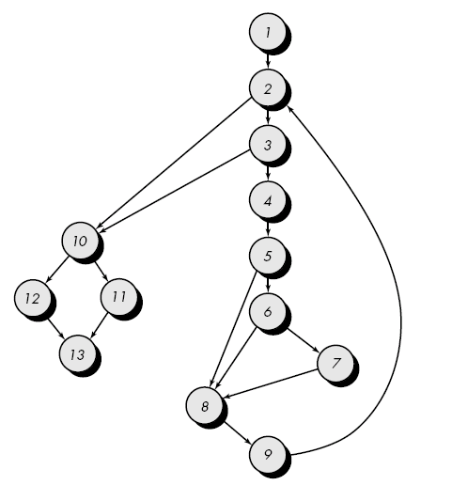
Cyclomatic Complexity Metrics

Slide 123
Cyclomatic Complexity Metrics
Determine the cyclomatic complexity of the resultant flow graph.
  V (G) can be determined without developing a flow graph by counting all conditional statements
  V (G) = 6 regions
  V (G) = 17 edges - 13 nodes + 2 = 6
  V (G) = 5 predicate nodes + 1 = 6

Slide 124
Cyclomatic Complexity Metrics
Determine a basis set of linearly independent paths
  path 1: 1-2-10-11-13
  path 2: 1-2-10-12-13
  path 3: 1-2-3-10-11-13
  path 4: 1-2-3-4-5-8-9-2-. . .
  path 5: 1-2-3-4-5-6-8-9-2-. . .
  path 6: 1-2-3-4-5-6-7-8-9-2-. . .
  The ellipsis (. . .) following paths 4, 5, and 6 indicates that any path through the remainder of the control structure is acceptable.
Prepare test cases that will force execution of each path in the basis set.

Slide 125
Halstead’s Measure
Halstead has also proposed a number of measure for complexity also.
  n1 is number of distinct operators
  n2 is number of distinct operands
  N1 is total occurrence of different operators in the program.
  N2 is total occurrences of different operands.
As any program must have at least two operators,
  One for function call
  One for end of statement.

Slide 126
Halstead’s Measure
Here ration N2/n2 represent the average number of times an operand is used.
Ratio will be larger, if variables are changed more frequently.
So program difficulty can calculated as
  D = (n1 * N2)/(2 * n2)

Slide 127
Knot Count
A method is based on the locations of the control transfers of the program.
This method is specifically designed for FORTRAN programs, where explicit transfer of control is shown by the use of goto statements.
A programmer draws arrow from the point of control transfer to its destination.
According to this metrics, more intertwined arrow indicate more complex program.

Slide 128
Knot Count
If (a < 5) goto L1
X=10
Goto L2
L1 x =15
L2 Continue
KNOT
A knot is essentially the intersection of two such control transfer arrows.
Problem arise while determining the knot count to programs using structured programs such as like while, for, etc.

Slide 129
Knot Count
So simply convert such a program into control transfers and then compute the knot count.

